Slide 1
Anomaly Detection for Condition Based Maintenance (CBM) using data-driven models

Slide 2
Overview of the Research Work
Our research group is focusing on Condition Based Maintenance (CBM).
Work on Tool Wear prediction using Data driven method is running on parallel.
This Work focuses on Anomaly Detection.
Anomaly Detection is a preliminary step in CBM flow.
Undetected anomaly may lead to an unexpected downtime which is expensive in terms of time and money.
As a part of this work we chose to work on chatter which is the safest of all anomalies proposed for simulation.

Slide 3
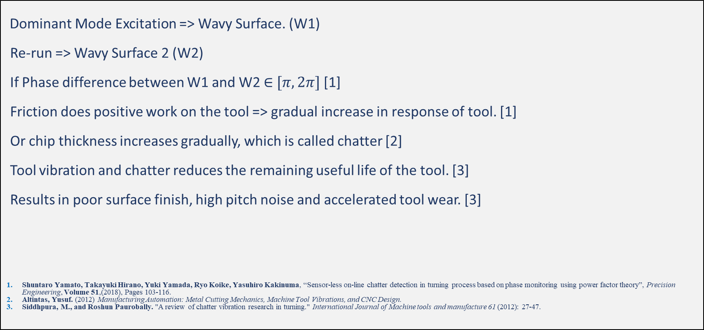
Chronology of Events in Chatter:
Dominant Mode Excitation => Wavy Surface. (W1)
Re-run => Wavy Surface 2 (W2)
If Phase difference between W1 and W2 $∈$ $[π, 2π]$ [1]
Friction does positive work on the tool => gradual increase in response of tool. [1]
Or chip thickness increases gradually, which is called chatter [2]
Tool vibration and chatter reduces the remaining useful life of the tool. [3]
Results in poor surface finish, high pitch noise and accelerated tool wear. [3]
Shuntaro Yamato, Takayuki Hirano, Yuki Yamada, Ryo Koike, Yasuhiro Kakinuma, “Sensor-less on-line chatter detection in turning process based on phase monitoring using power factor theory”, Precision Engineering, Volume 51,(2018), Pages 103-116.
Altintas, Yusuf. (2012) Manufacturing Automation: Metal Cutting Mechanics, Machine Tool Vibrations, and CNC Design.
Siddhpura, M., and Roshun Paurobally. "A review of chatter vibration research in turning." International Journal of Machine tools and manufacture 61 (2012): 27-47.

Slide 4
Initial Proposal for Work:
Experiments will be conducted on a New CNC.
The data will be collected from the internal sensors and a Dynamometer.
The tool current, and spindle motor current data will be correlated with force data.
A chatter detection method using current data will be proposed based on results from experiment.

Slide 5
Experimental Details

Slide 6
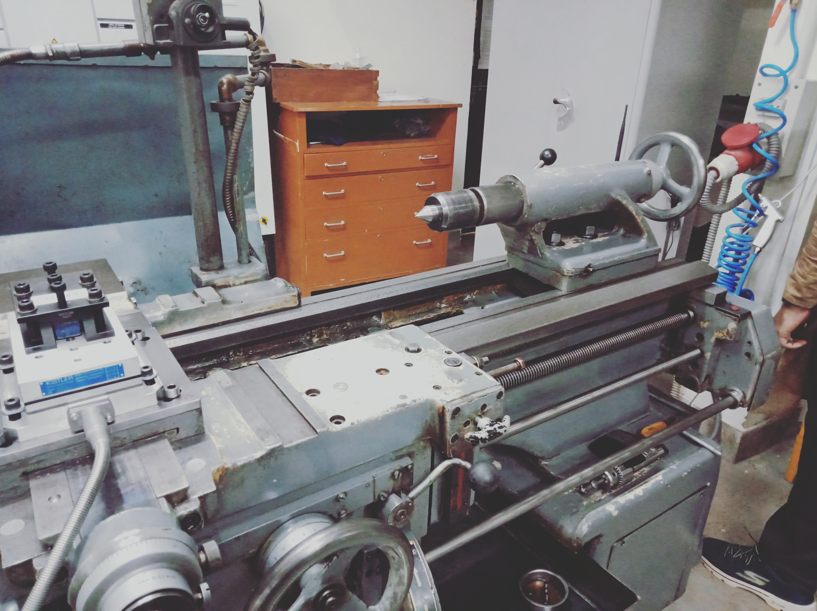
Experimental Setup

Slide 7
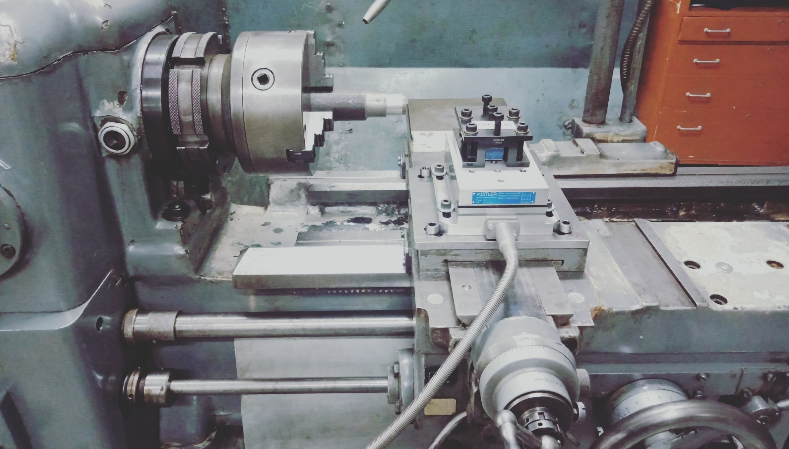

Slide 8
Workpiece and tool selected
Work piece material: AISI-H-13 steel of length 191 mm
Tool material: CNMG 120408 EM TT9080 insert. http://www.imc-companies.com/taegutec/ttkcatalog/Grade.aspx?grade=TT9080&item=6172073&fnum=1813&mapp=IS&app=377

Slide 9
Sensors available
Piezoelectric dynamometer
Tri-axial accelerometer
Microphone
Acoustic emission sensor

Slide 10
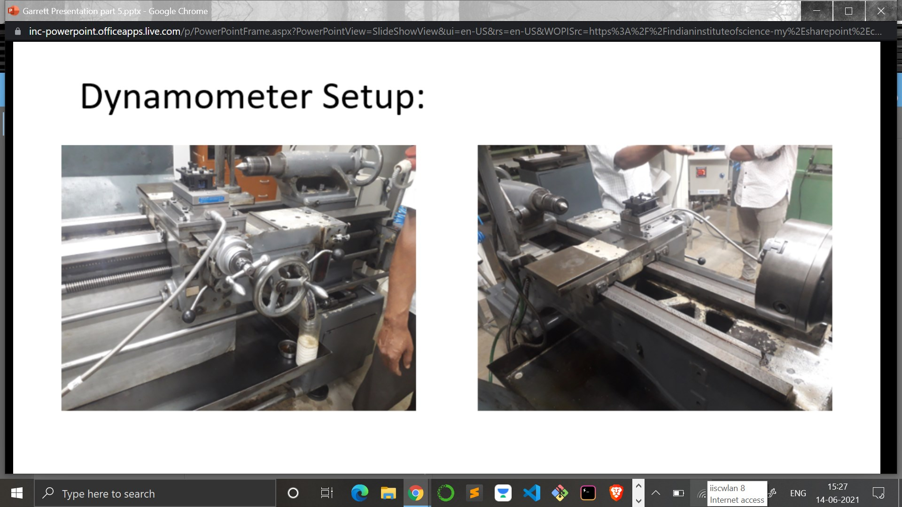
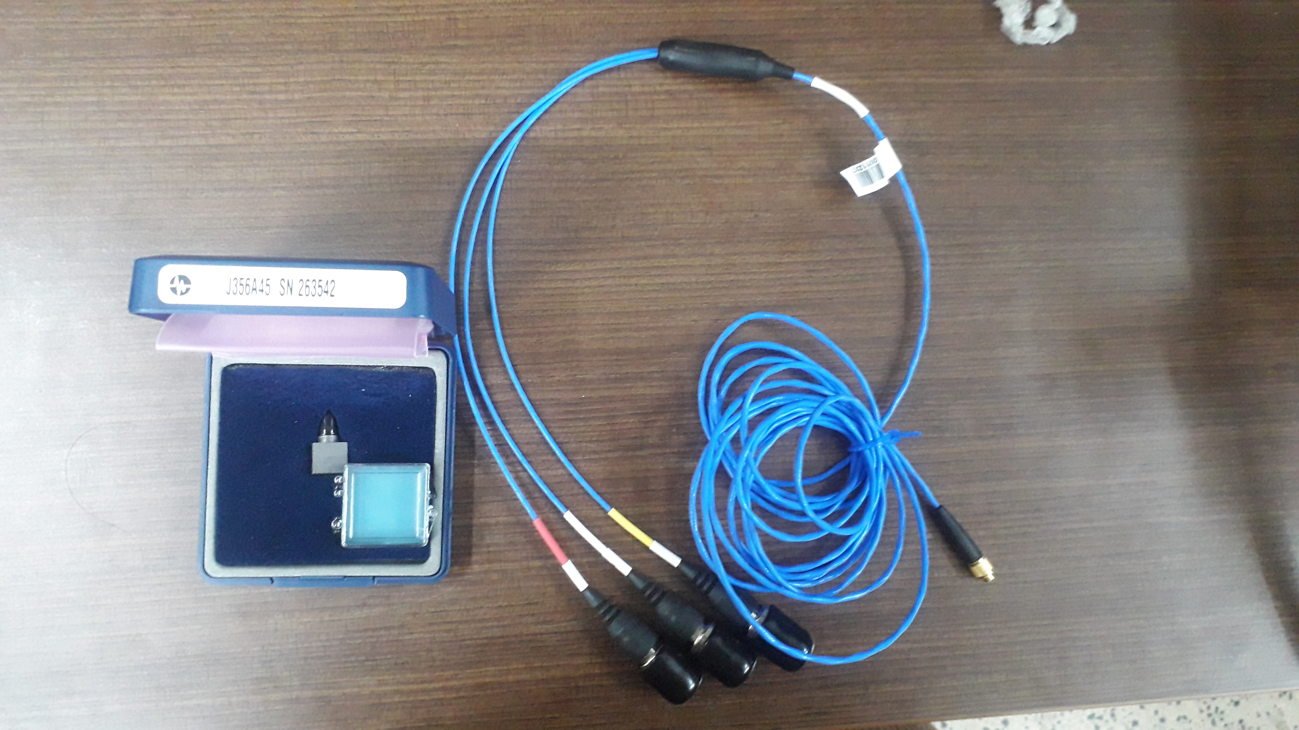
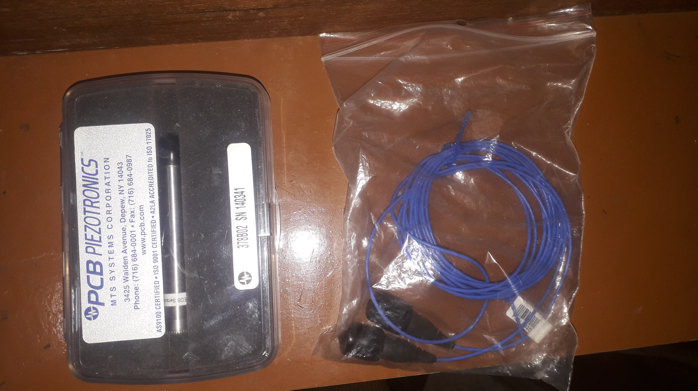
Accelerometer
Dynamometer
Microphone

Slide 11
Experiments performed
Experimental Runs | Cutting speed (rpm) | Feed rate (mm/rev) | Depth of cut (mm) | Starting diameter of workpiece (mm) | Finishing diameter of workpiece (mm) | Remarks
1 | 1000 | 0.05 | 1 | 37 | 35 | No chatter observed
2 | 1000 | 0.05 | 2 | 35 | 31 | Continuous chip formation observed leading to hindrance in tool path causing chatter
3 | 1000 | 0.05 | 2 | 31 | 27 | No chatter observed but noise was produced during cutting
4 | 1260 | 0.05 | 2 | 27 | 23 | No chatter observed
5 | 1260 | 0.2 | 1.5 | 23 | 20 | No chatter observed
6 | 640 | 0.1 | 1 | 20 | 18 | No chatter observed
7 | 640 | 0.1 | Not measured | 18 | Not measured | Chatter observed due to high tool overhang (44 mm)

Slide 12
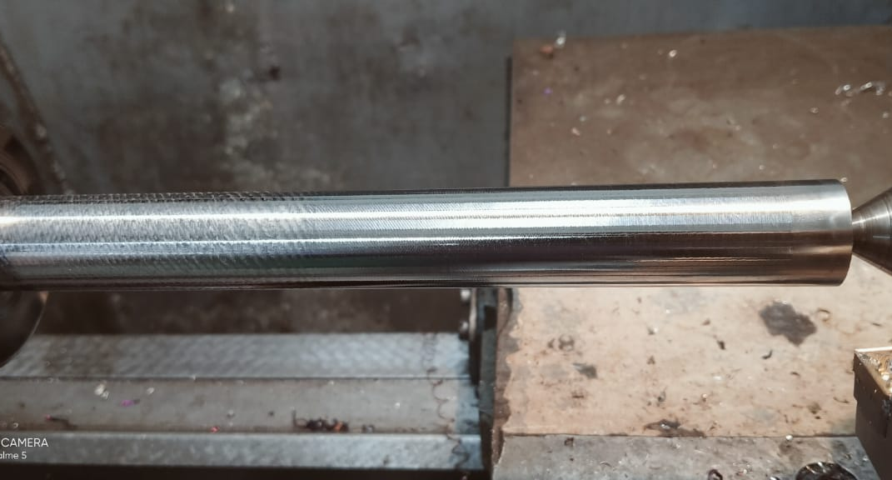

Slide 13
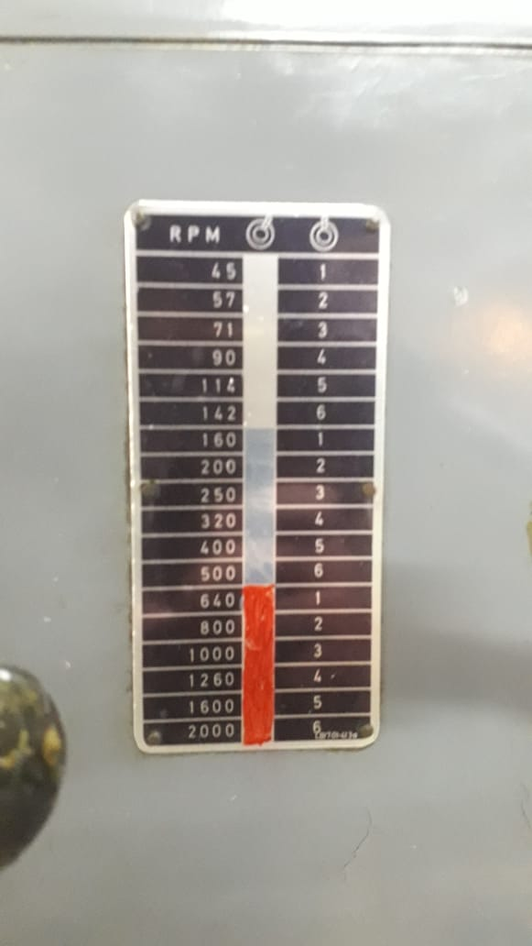
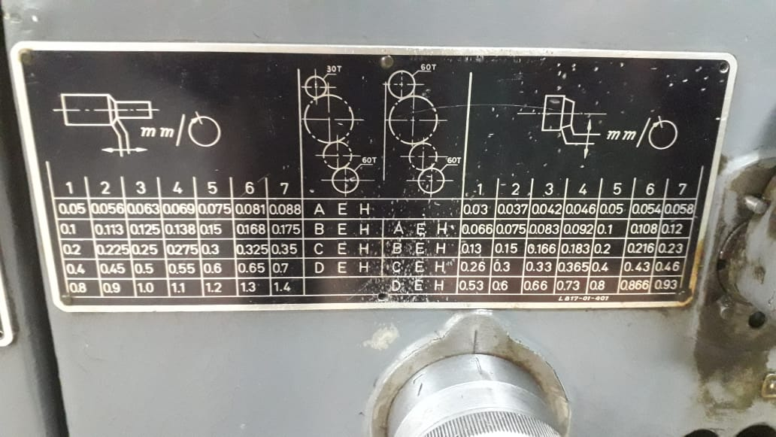
Range of Cutting speed and Feed rate

Slide 14
Detection of chatter in turning using data learning models
By:
Sayantika Ghosh
M.Tech Smart Manufacturing
Reg. No.: 17136

Slide 15
Experimental Details as given by Yesilli 2019
Yesilli MC, Khasawneh FA, Otto A. Chatter Detection in Turning Using Machine Learning and Similarity Measures of Time Series via Dynamic Time Warping. arXiv:1908.01678v1 [eess.SP]. 2019.

Slide 16
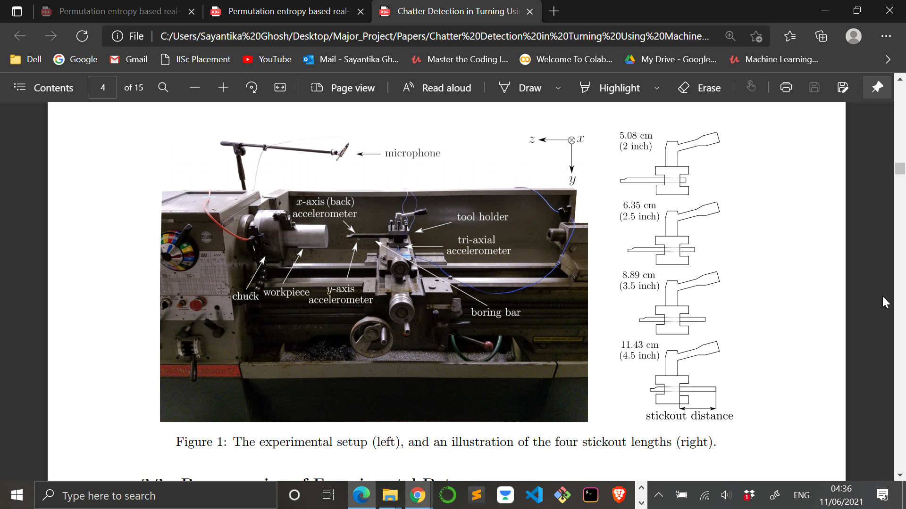
Experimental Setup
Clausing-Gamet 33 cm (13 inch) engine lathe
0.04 cm (0.015 inch) radius Titanium nitride coated insert
S10R-SCLCR3S boring bar

Slide 17
Sensors used
Two PCB 352B10 uniaxial accelerometers
One PCB 356B11 triaxial accelerometer
One PCB 130E20 microphone
Terahertz LT880 laser tachometer

Slide 18
Preprocessing of experimental data
Raw data (triaxial accelerometer data along x-axis) with a sampling frequency of 160 kHz
Filtering using Butterworth low pass filter of order 100
Downsampling to 10 kHz
Processed data

Slide 19
Data Tagging
 | Chatter | Mild Chatter | Stable (Chatter - free)
Time domain feature (Acceleration amplitude) | High | Low | Low
Frequency domain feature (amplitude for frequency below 5 kHz) | High | High | Low

Slide 20
Values of cutting speed, depth of cut and stickout distances used
Cutting speed (rpm) | Depth of cut (milliinches) | Stickout distance (inches)
320, 425, 570, 770, 1030 | 1, 2, 3, 5, 8, 10, 12, 13, 14, 15, 16, 17, 20, 25, 30, 35, 40, 45, 50, | 2, 2.5, 3.5, 4.5

Slide 21
Dataset used
Raw and processed data available from the following works:
Khasawneh F, Otto A, and Yesilli M. Turning dataset for chatter diagnosis using machine learning. Mendeley Data, v1. http://dx.doi.org/10.17632/hvm4wh3jzx.1. 2019.
Yesilli MC, Khasawneh FA, and Otto A. Topological feature vectors for chatter detection in turning processes. arXiv:1905.08671. 2019.
Yesilli MC, Khasawneh FA, and Otto A. On transfer learning for chatter detection in turning using wavelet packet transform and empirical mode decomposition. arXiv:1905.01982. 2019

Slide 22
Methodology followed for chatter prediction

Slide 23
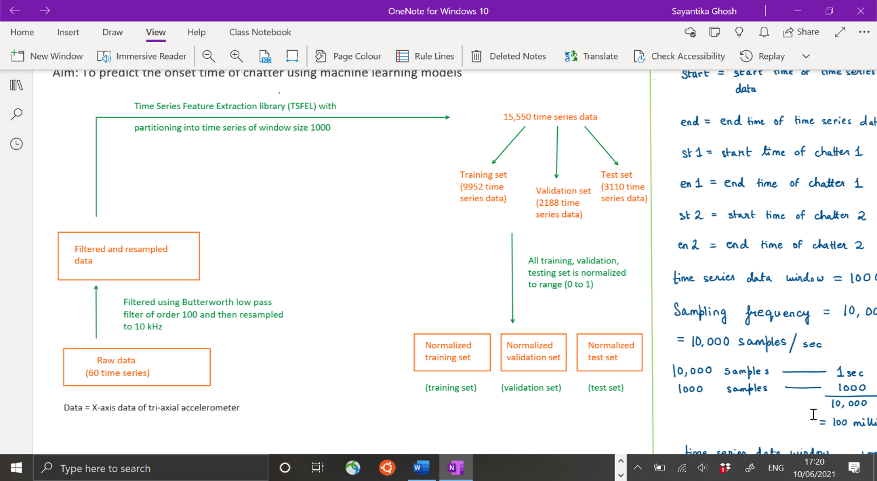
Illustration showing the flow of the preprocessing steps for chatter onset time prediction

Slide 24
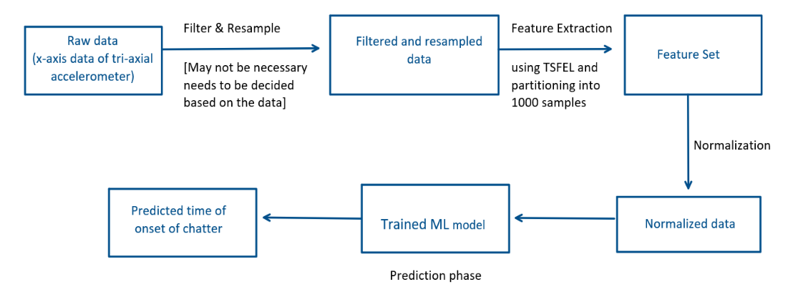
Illustration showing the flow of steps for real time prediction of chatter onset time

Slide 25
Extra time computation for real time prediction of onset of chatter
Filtering and resampling time (Ta)
Feature extraction time (Tb)
Normalization time (Tc)
Time of prediction (Td)
In the system used in this work these times were:
Ta ~ 0.165 milliseconds approx.
Tb ~ 0.239 milliseconds approx.
Tc ~ 0.0466 milliseconds approx.
Td ~ 0.015 milliseconds approx.
___________________________________
Total time ~ 0.465 milliseconds approx.
___________________________________

Slide 26
Algorithm for labelling the data for chatter onset time prediction

Slide 27
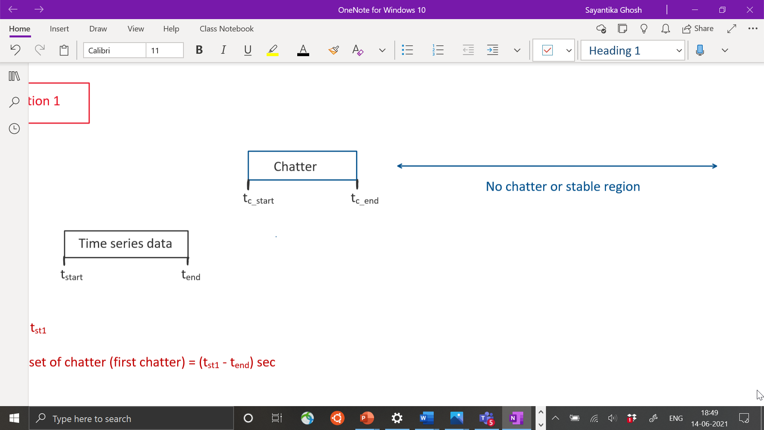
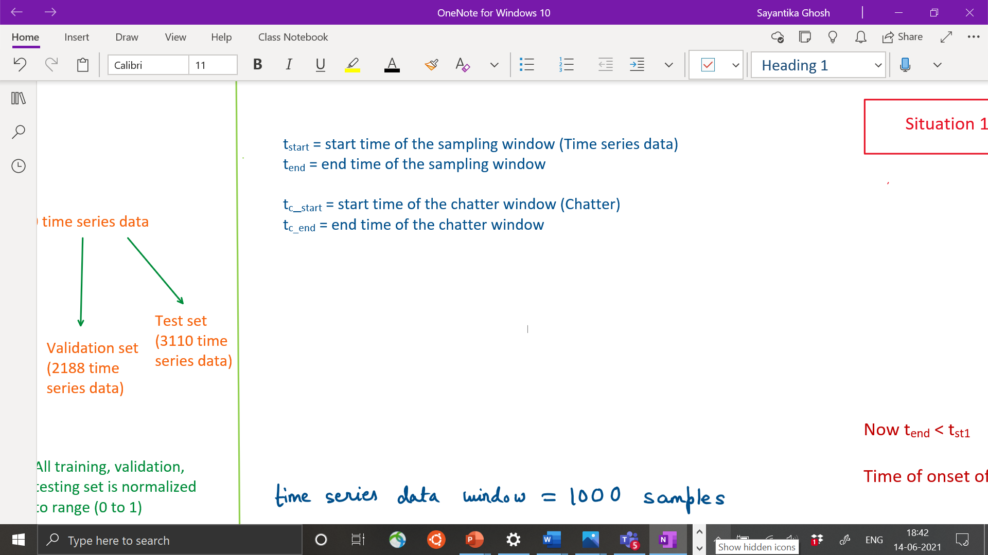
Cases | Labels
tend < tc_start | tc_start – tend
tend >= tc_start and tstart <= tc_end | 0
tstart > tc_end | -1 [signifying no chatter region ahead]

Slide 28
Determination of chatter window time

Slide 29
Information about plots in the coming slides
 | PLOT A | PLOT B
Condition | No chatter | Chatter
Cutting Speed (rpm) | 320 | 1030
Depth of cut (milliinches) | 15 | 2
Stickout distance (inches) | 2 | 3.5

Slide 30
Time domain plot having acceleration in y-axis and time in x-axis

Slide 31
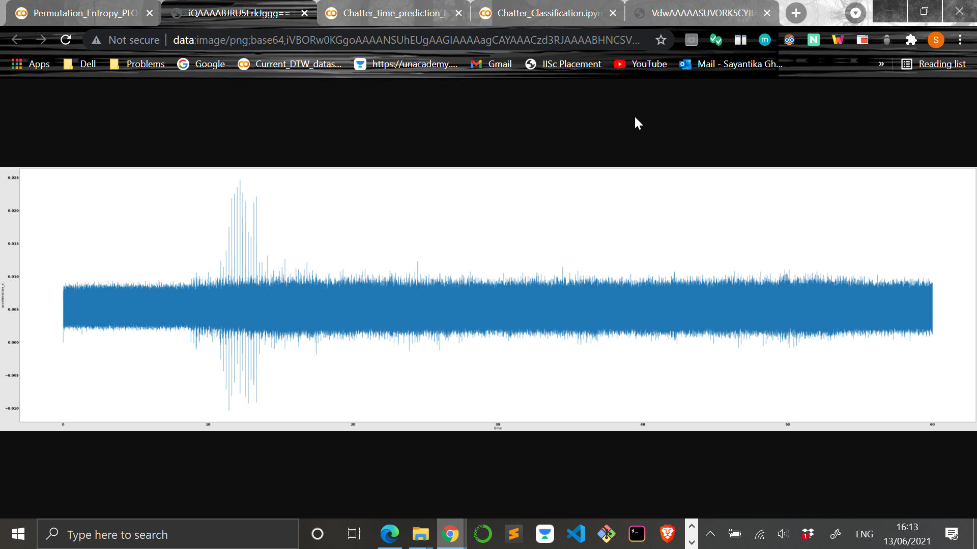
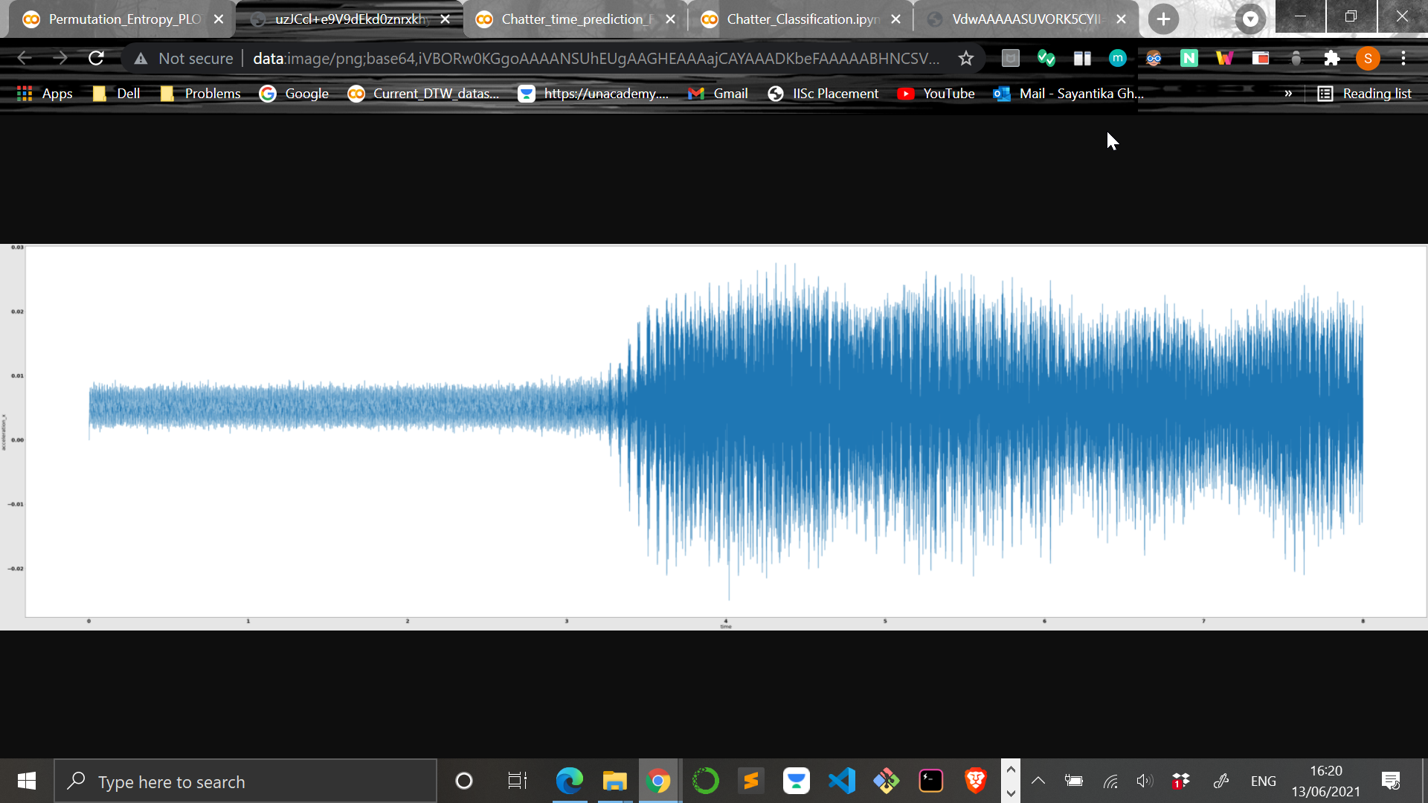
PLOT A (no chatter)
PLOT B (chatter)

Slide 32
Permutation Entropy (PE) plot having PE in y-axis and time in x-axis

Slide 33
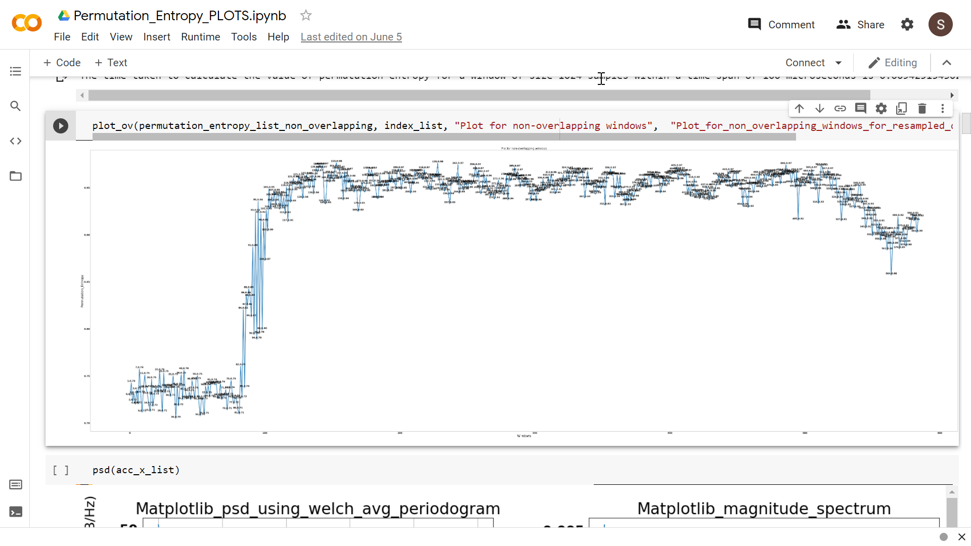
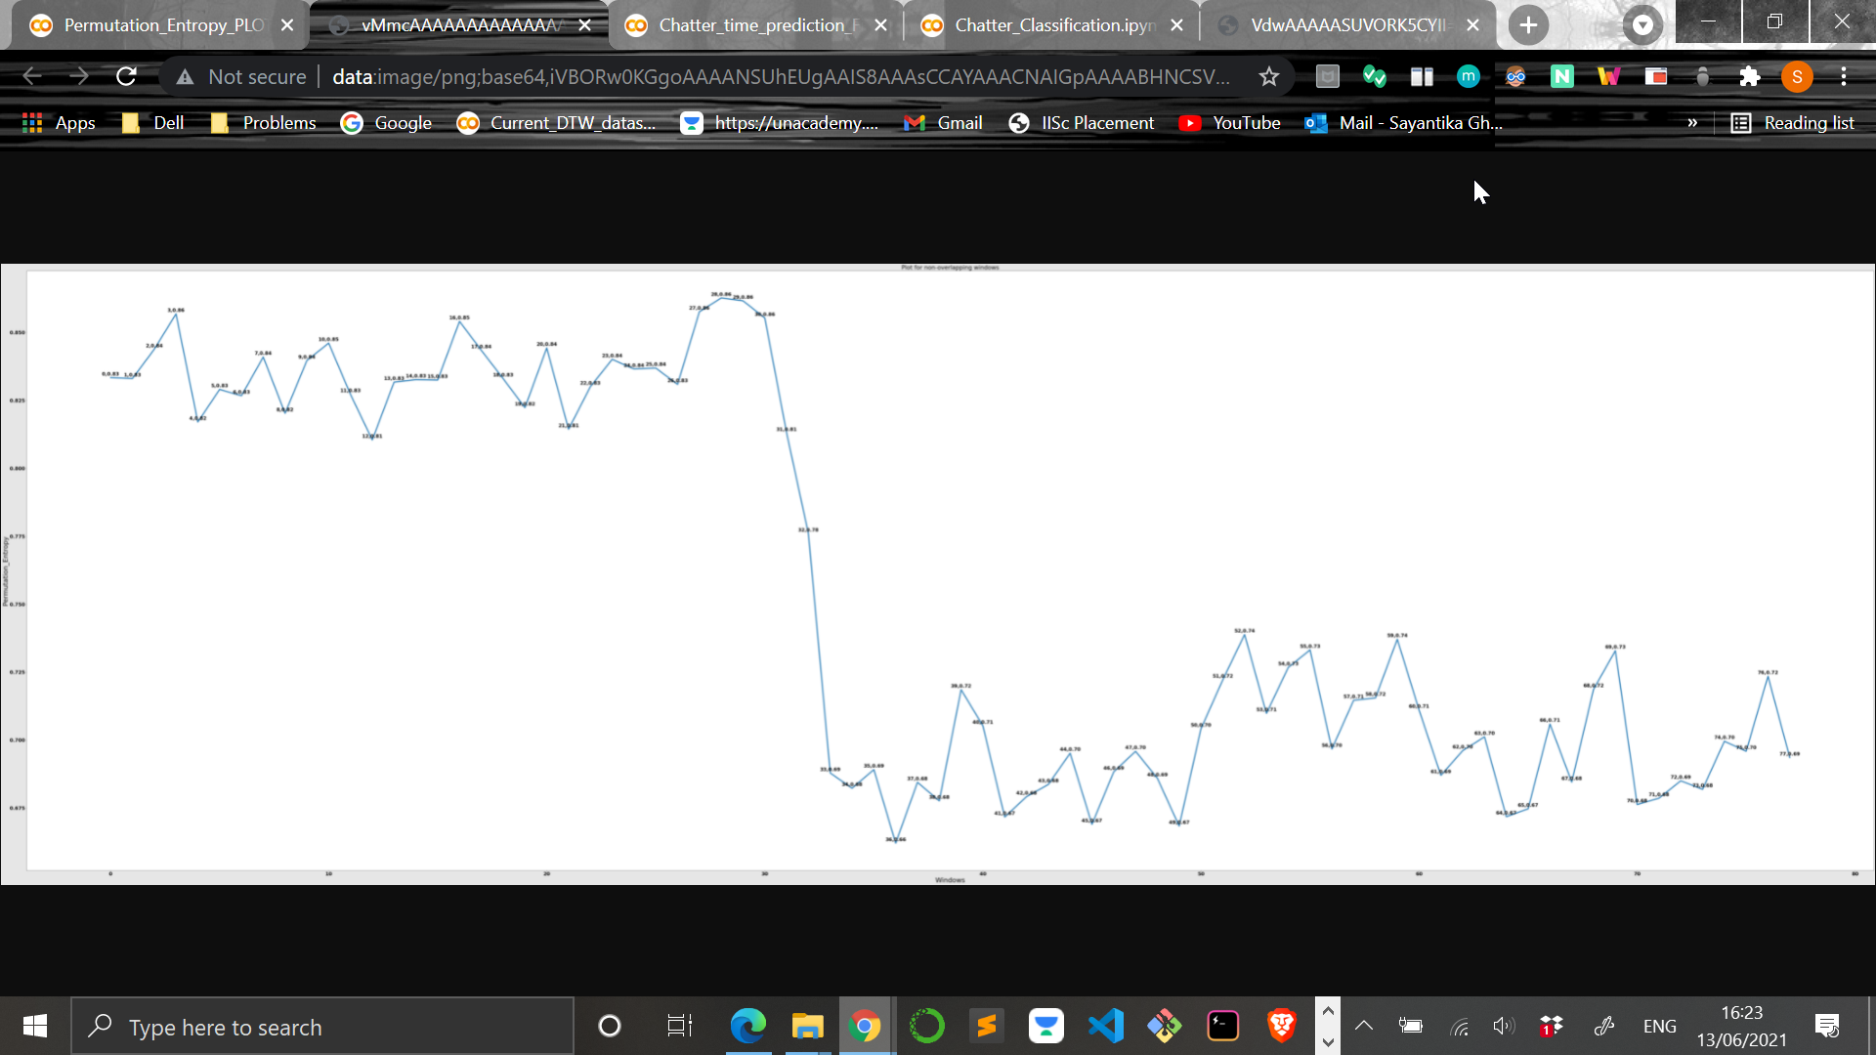
PLOT A (no chatter)
PLOT B (chatter)

Slide 34
Spectrogram plot having frequency in y-axis and time in x-axis using matplotlib and scipy library

Slide 35
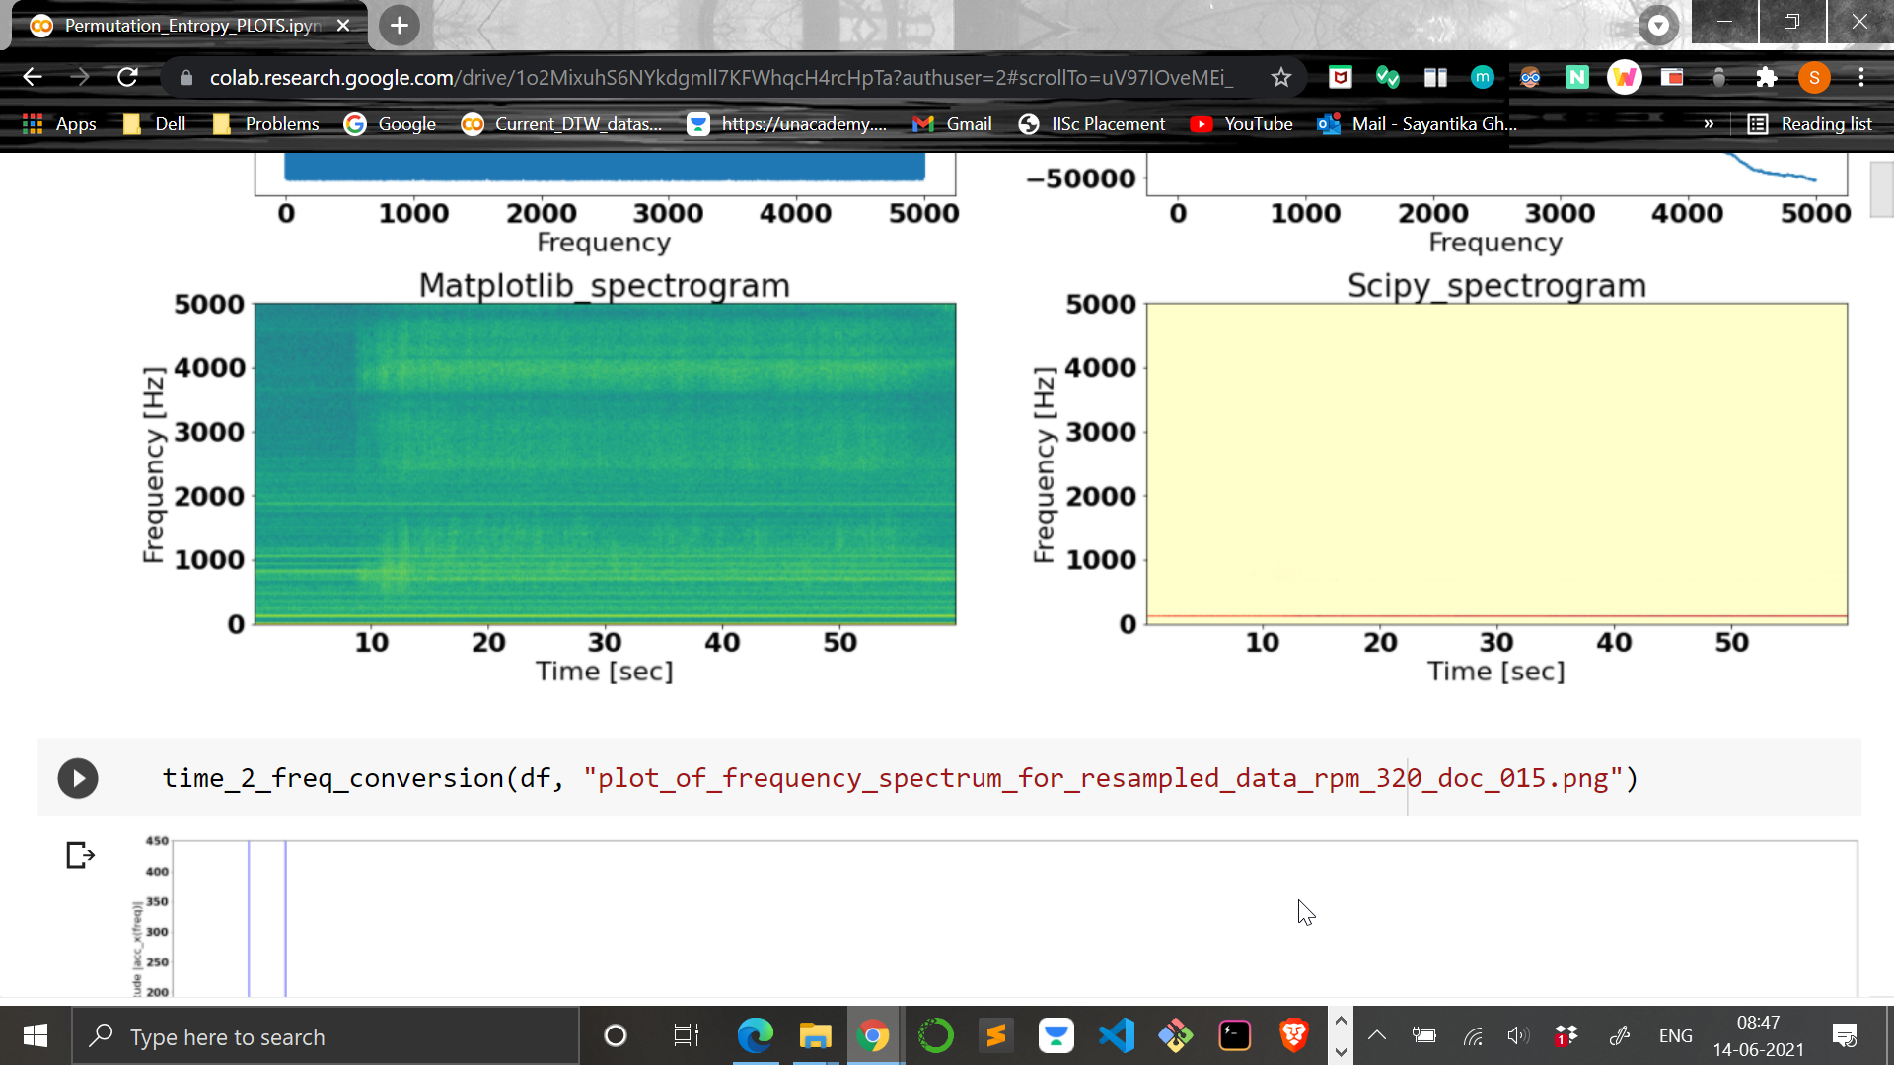
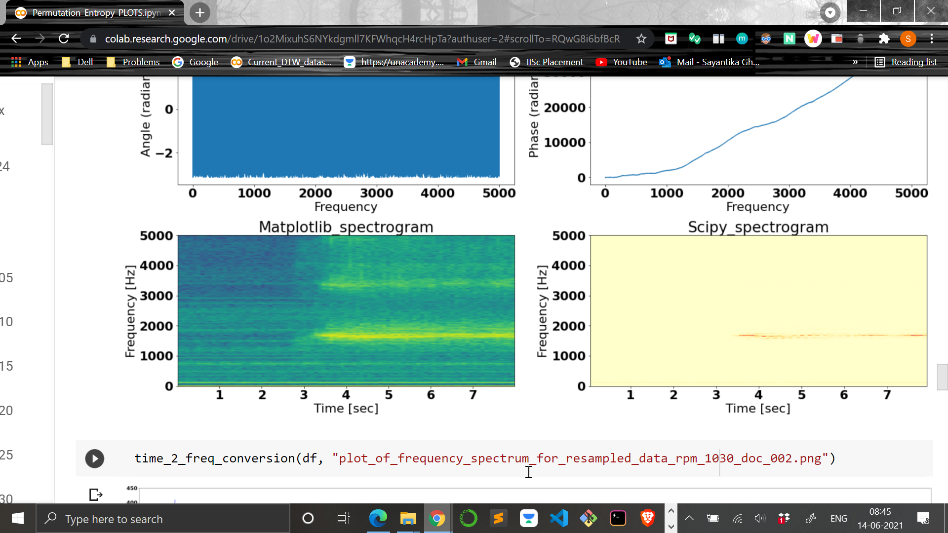
PLOT A (no chatter)
PLOT B (chatter)

Slide 36
Magnitude spectrum plot having frequency magnitude (energy) in y-axis and frequency in x-axis

Slide 37
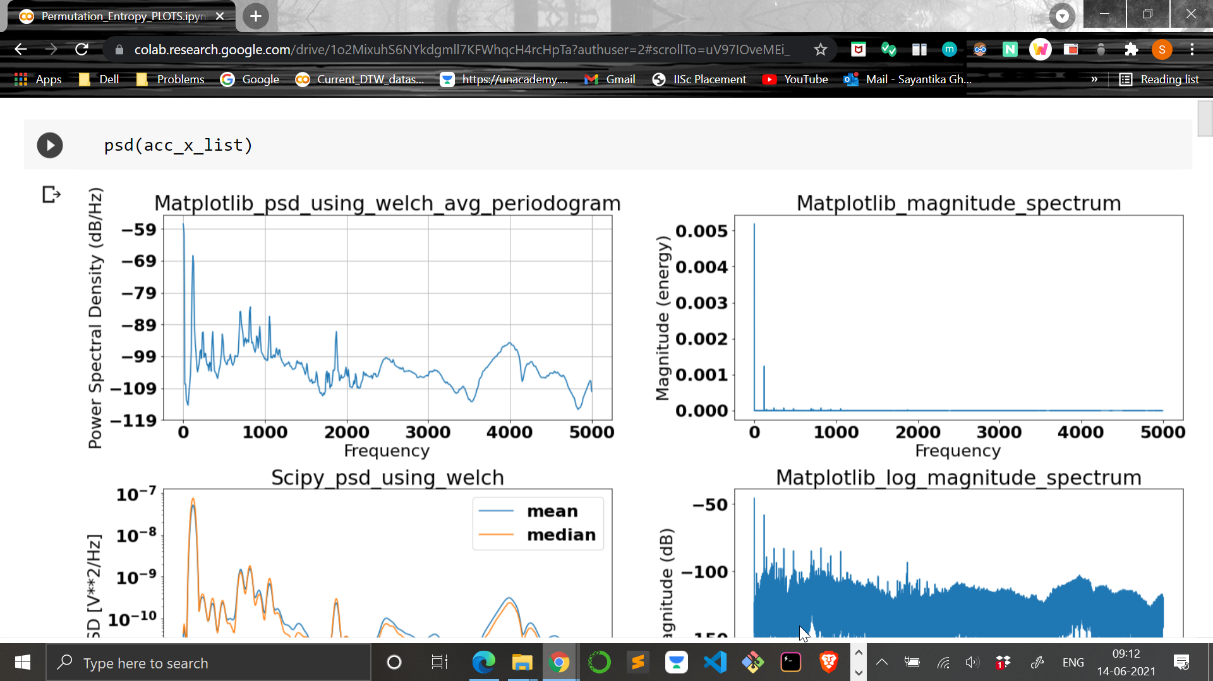
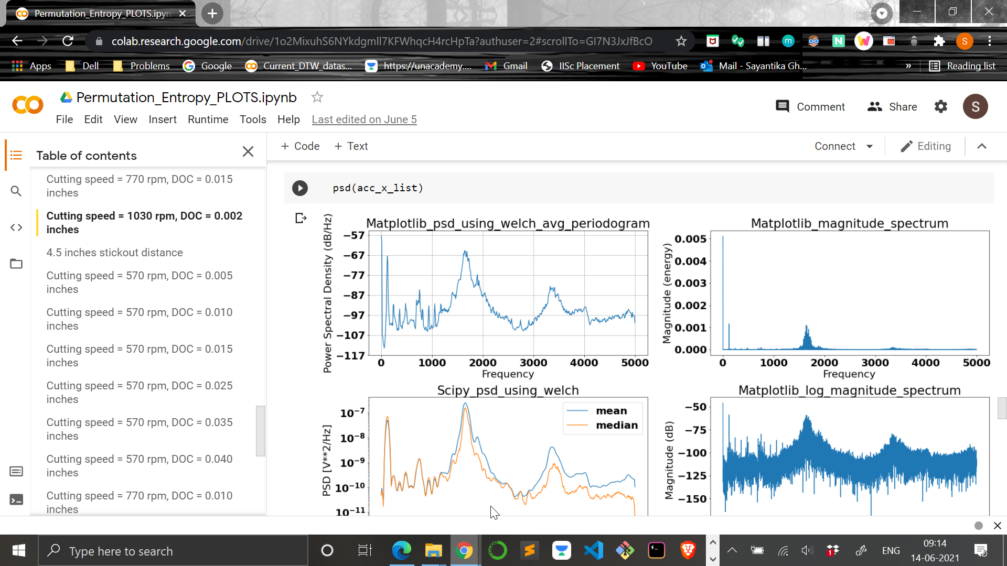
PLOT A (no chatter)
PLOT B (chatter)

Slide 38
Results

Slide 39
Chatter Detection Results

Slide 40
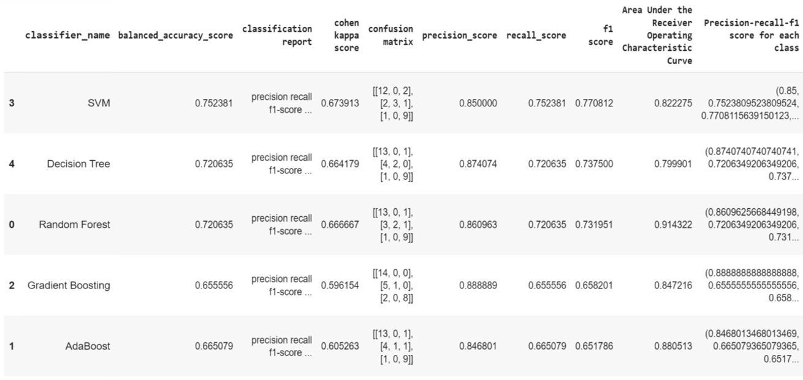
Classification performance metric results for the different classifiers used

Slide 42
Confusion Matrix
 | True Labels
Predicted Labels |  | No chatter | Mild chatter | Chatter
 | No chatter | 12 | 0 | 2
 | Mild chatter | 2 | 3 | 1
 | Chatter | 1 | 0 | 9

Slide 43
Outcomes defined for chatter class
True Positive
True Negative
Model classifies as not a chatter is actually not a chatter
False Positive
Model classifies as chatter is actually not a chatter
False Negative
Model classifies as not a chatter is actually a chatter
Model classifies as chatter is actually a chatter

Slide 44
Precision for chatter class = True Positive / (True Positive + False Positive)
Recall for chatter class = True Positive / (True Positive + False Negative)
F1 score for chatter class = (2 * precision for chatter class * recall for chatter class) / (precision for chatter class + recall for chatter class)
Macro-averaged metrics calculates metrics for each class individually and then taken unweighted mean of the measures.
Macro-averaged precision = (precision for chatter class + precision for mild chatter class + precision for no chatter class) / 3
Macro-averaged recall = (recall for chatter class + recall for mild chatter class + recall for no chatter class) / 3
Macro-averaged f1 = (f1 for chatter class + f1 for mild chatter class + f1 for no chatter class) / 3

Slide 45
Chatter Onset Time Prediction Results

Slide 46
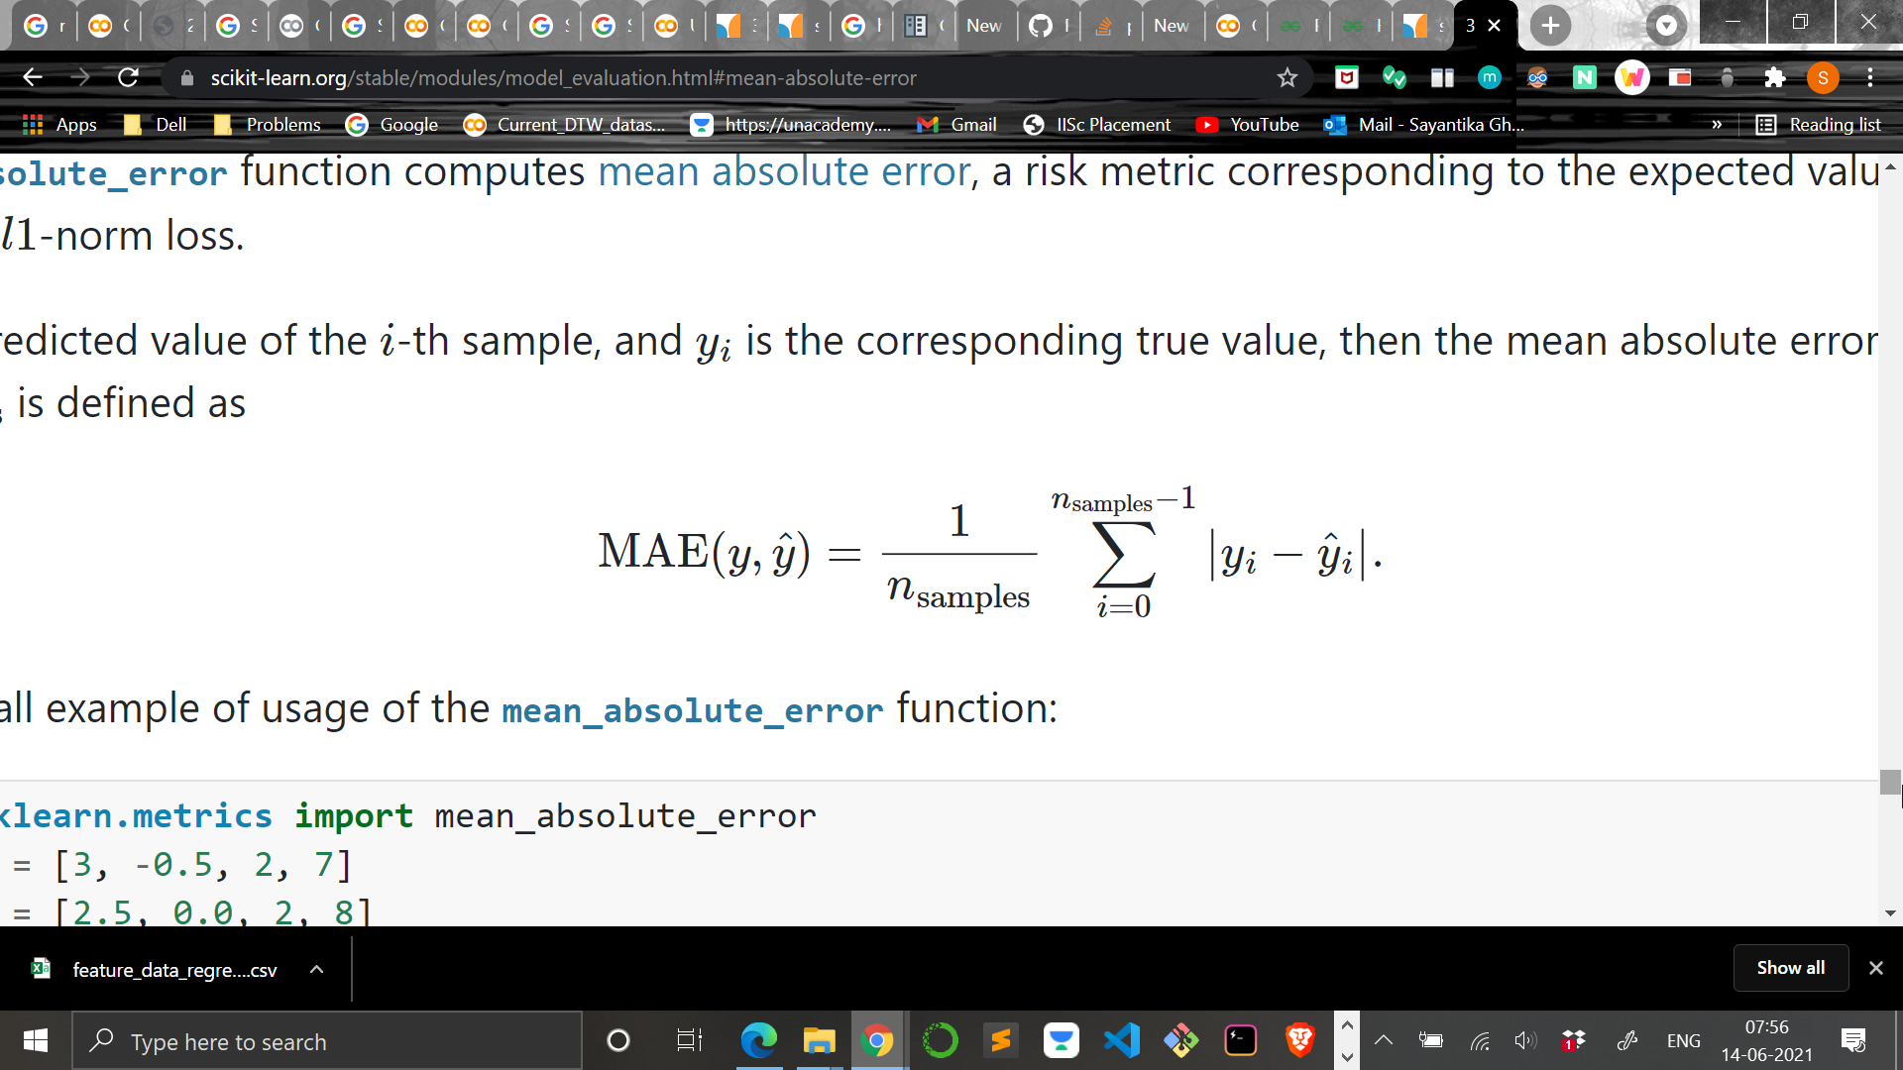
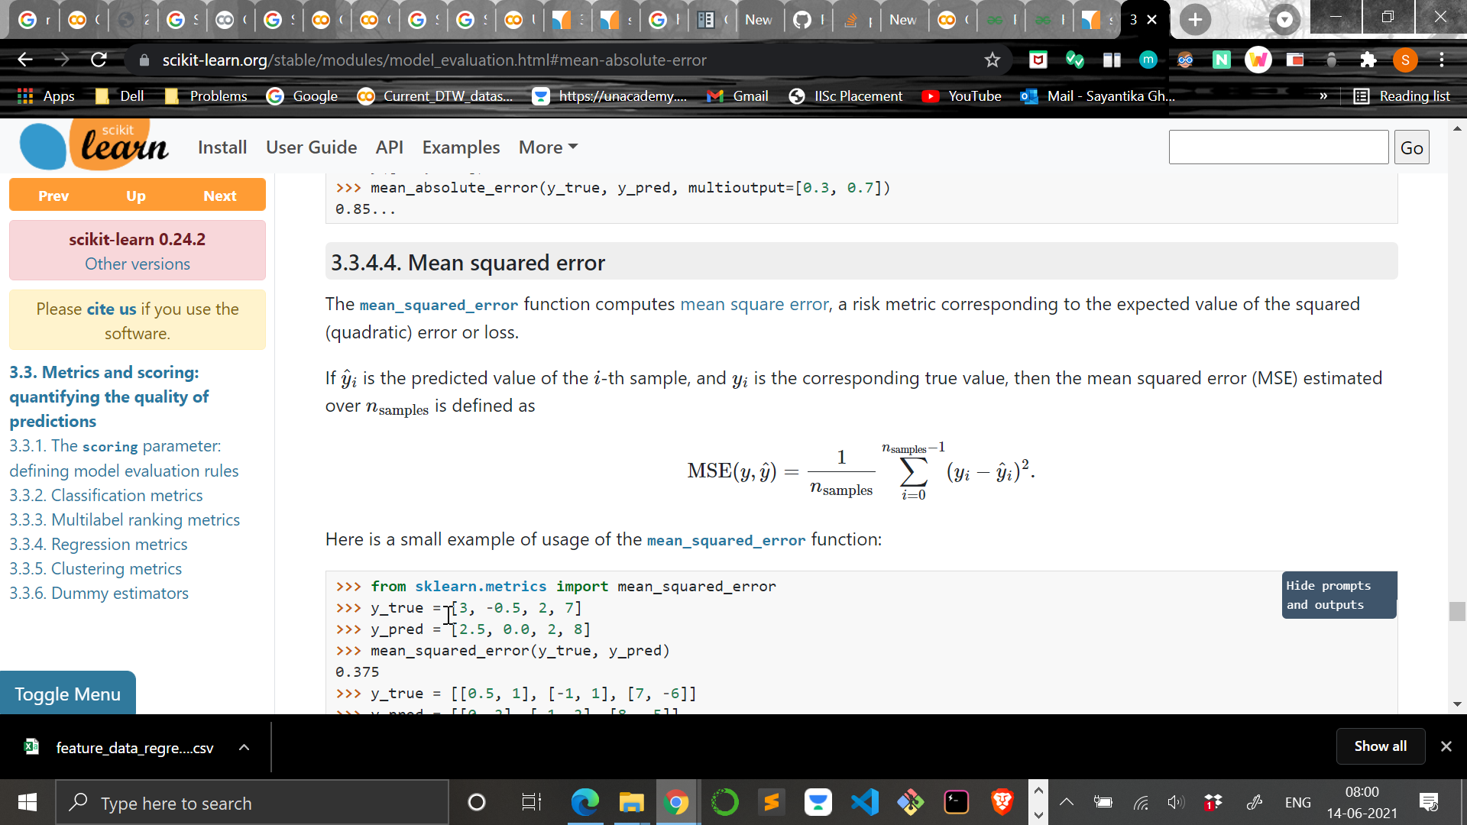
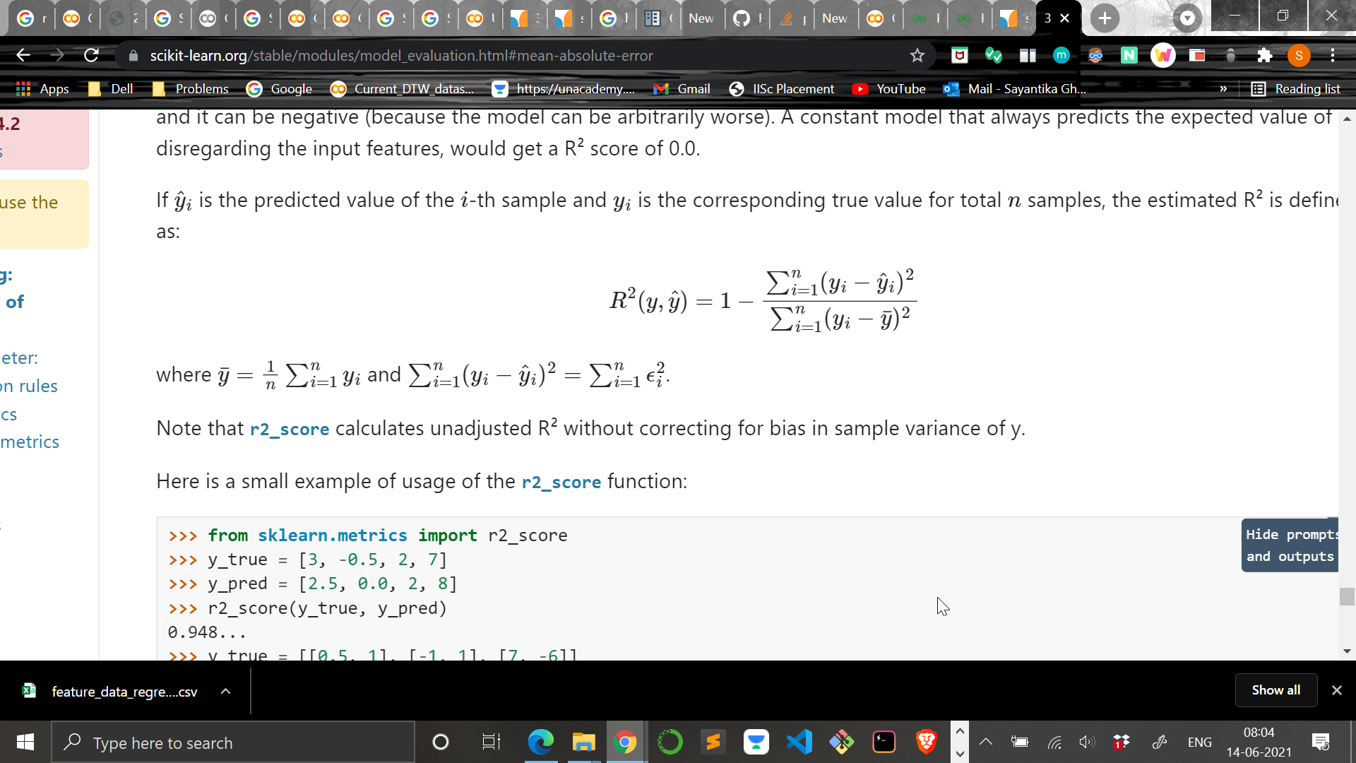
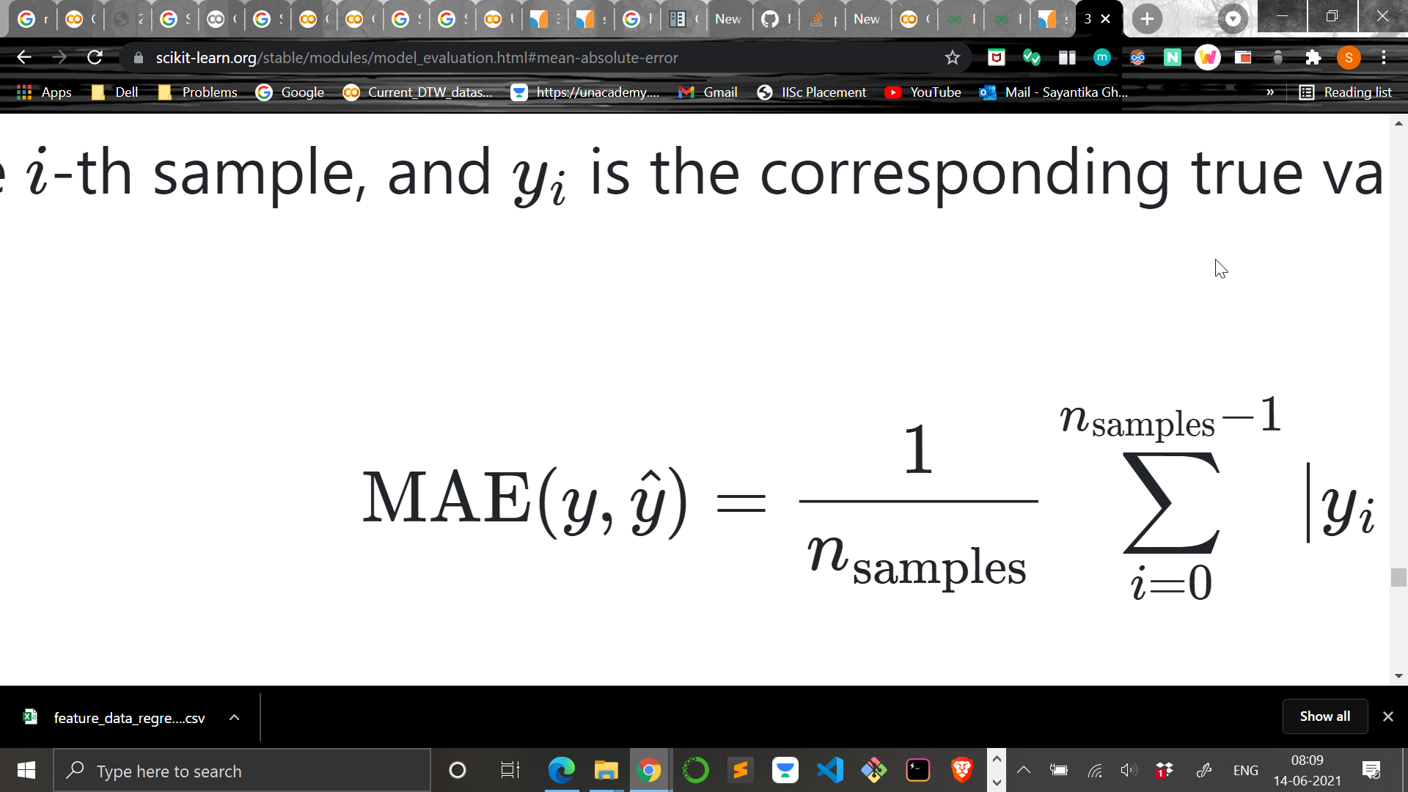
Mean Absolute Error (MAE) is given by the formula:
Mean Squared Error (MSE) is given by:
R squared score is given by:
Adjusted r - squared score is given by: 1 - (((1 – R squared score) * (n_{samples} – 1))/(n_{samples} – p – 1))
Cross-validation score is calculated by cross-validation based on the score of the estimator. It defaults to the scoring parameter used.
represents Predicted values
represents total sample size
represents Actual values
k represents number of predictors

Slide 47
Regression performance metric results for the different regressors used
Regressor Name | Mean Absolute Error (sec) | Root Mean Squared Error (sec) | R squared Score | Adjusted r squared
Extra tree | 0.279686 | 0.766447 | 0.98189 | 0.980124
Random forest | 0.424569 | 1.142887 | 0.959732 | 0.955805
Decision tree | 0.405969 | 1.473049 | 0.933106 | 0.926582
AdaBoost | 0.268911 | 1.968465 | 0.880544 | 0.868893
Gradient boosting | 0.911144 | 2.19202 | 0.85187 | 0.837423
XgBoost | 0.937246 | 2.267219 | 0.841532 | 0.826077
Rigde regression | 2.266629 | 5.544729 | 0.052204 | -0.04023
Elastic net CV | 2.260588 | 5.546856 | 0.051476 | -0.04103
Linear regression | 2.283518 | 5.555082 | 0.048661 | -0.04412
Bayesian ridge regression | 2.267463 | 5.561342 | 0.046516 | -0.04648
Stochastic gradient descent | 2.151204 | 5.585865 | 0.038088 | -0.05573
Lasso regression | 2.466575 | 5.699609 | -0.00149 | -0.09916
SVM SVR | 1.412533 | 5.704305 | -0.00314 | -0.10097

Slide 48
Regression performance metric results for the different regressors used contd
Regressor name | Cross validation score mean | Cross validation score std | R squared train | R squared val | R squared test
Extra tree | 0.976661 | 0.006662 | 1 | 0.983679 | 0.978671
Random forest | 0.93389 | 0.019157 | 0.990997 | 0.961495 | 0.948948
Decision tree | 0.88614 | 0.044887 | 1 | 0.933106 | 0.909869
Ada boost | 0.960697 | 0.025788 | 0.999979 | 0.880536 | 0.853348
Gradient boosting | 0.813571 | 0.021242 | 0.855675 | 0.84982 | 0.825488
XgBoost | 0.796918 | 0.019985 | 0.848614 | 0.840176 | 0.806567
Rigde regression | 0.037921 | 0.013219 | 0.04887 | 0.048847 | 0.042505
Elastic net CV | 0.038606 | 0.011691 | 0.046733 | 0.049494 | 0.044677
Linear regression | 0.029677 | 0.019107 | 0.050423 | 0.03975 | 0.03466
Bayesian ridge regression | 0.03573 | 0.009339 | 0.041479 | 0.046268 | 0.043073
Stochastic gradient descent | 0.033377 | 0.011283 | 0.035068 | 0.038035 | 0.036428
Lasso regression | -0.00184 | 0.00299 | 0 | -0.00149 | -0.00015
SVM SVR | 0.062933 | 0.037197 | 0.067503 | 0.008181 | 0.04352

Slide 49
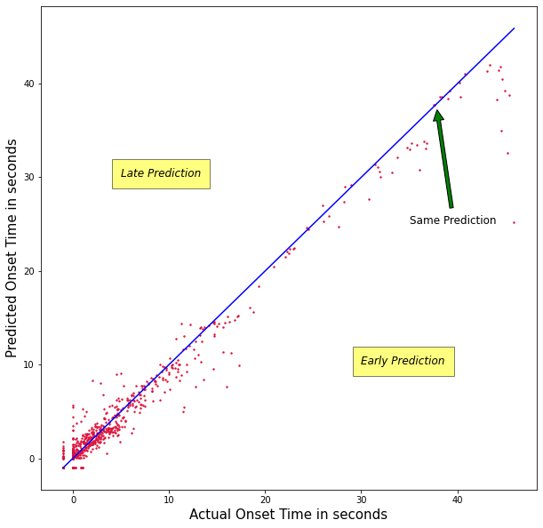
Plot showing early, just in time and late predictions for the test set
Just in time Prediction

Slide 51
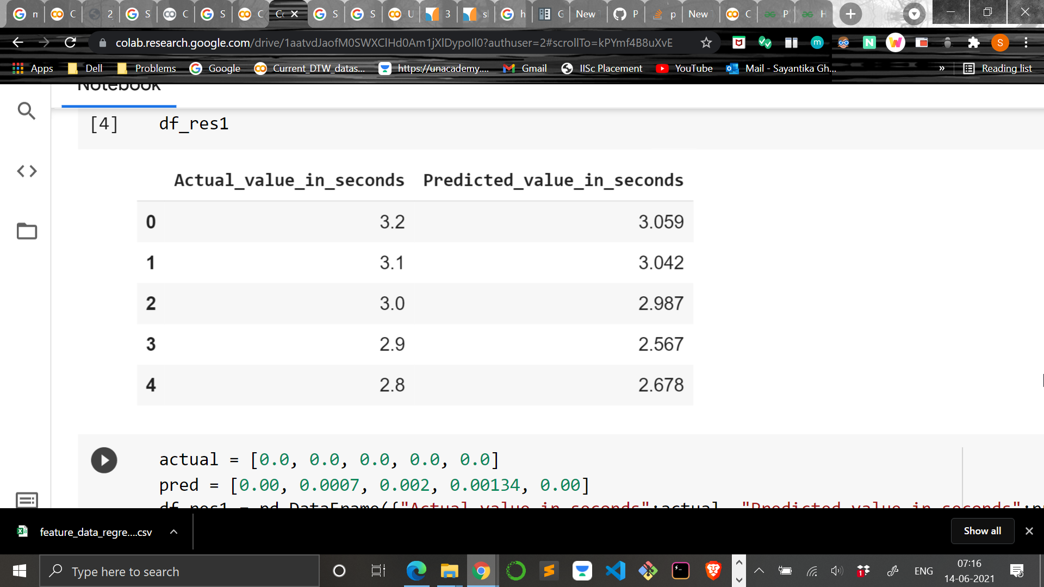
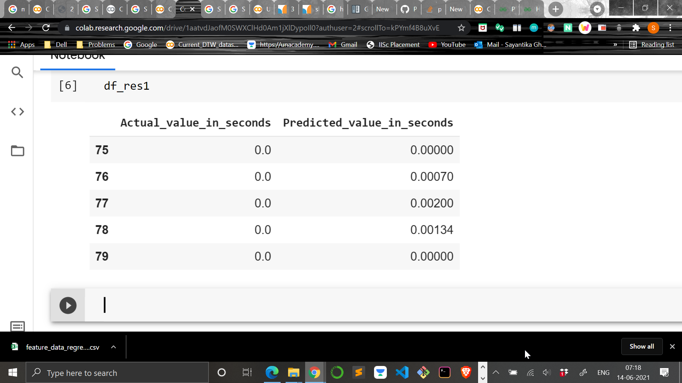
Table showing the prediction results of one of the time series in the test set
.
.
.
.
Here 0 second represents that the chatter has already started

Slide 52
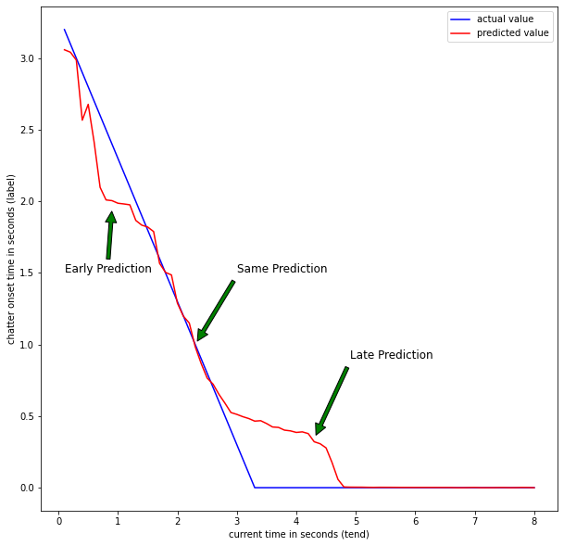
Time domain plot showing acceleration on y-axis and time on x-axis for stickout distance 3.5 inches, cutting speed 1030 rpm and depth of cut 2 milliinches and the corresponding chatter onset time plot
Just in time Prediction

Slide 53
Conclusion

Slide 54
Dynamic Time Warping (DTW) computes the similarity between two time series. Though it required no preprocessing and can work on small number of datasets, it was very slow and computationally expensive.
Permutation entropy is simple and computationally very fast. But there were some time series in which conflict occurred between the time of onset given by the sharp drop in the value of PE and the time given by the authors. So it was not used as a feature for the final modelling.
The technique followed here uses an automatic feature extraction library (TSFEL) which calculated approx. 300 features for each of the time series in the time and frequency domain.
This method looks promising because the early and just in time prediction were 85% of the test set (3110 time series) and also the errors were less.
This trained model is suitable for online prediction of chatter onset time.

Slide 55
Future prospects

Slide 56
This model for the prediction of onset time current cannot classify between mild and full chatter. So this is an aspect which needs to be looked upon.
Here only the x-axis signal of tri-axial accelerometer was taken but the model could also be trained on a dataset considering other sensors like dynamometer, microphone, etc.
In this work only machine learning algorithms were tried but further can look for various deep learning architectures like Long Short Term Memory (LSTM) and others.

Slide 57
Thank you

